Slide 1
Advancing Web Application Performance Testing: A Review of Machine Learning, Deep Learning, and Reinforcement Learning Approaches

Slide 2

Agenda
Introduction
Machine Learning-Based Approaches
Deep Learning-Based Approaches
Reinforcement Learning-Based Approaches
Comparative analysis
Research Gaps
Conclusion and Future work

Slide 3

What is Webpage Performance Testing?
Notes:
Before we dive into machine learning or reinforcement learning, let's first ground ourselves in the core question:
What exactly is webpage performance testing?
In simple terms, it's the process of evaluating how fast, efficient, and responsive a web page is when accessed by users. It involves measuring key metrics like page load time, time to interactive, resource usage, and server response time.
The goal is to ensure that a website not only looks good — like what you see here — but also performs smoothly across different devices, browsers, and user conditions.
Poor performance directly impacts user satisfaction, bounce rates, and even SEO rankings. So in today's fast-moving, high-expectation digital world, performance testing has become just as important as functionality or design.

Slide 4

Why use AI?
Notes:
So now that we understand what webpage performance testing is — the next question is:
Why use AI to do it?
Traditional performance testing can be slow, expensive, and often reactive. You write scripts, set thresholds, run stress tests — and only then do you find out what breaks.
But with AI, performance testing becomes smarter, faster, and adaptive.
Machine Learning can predict problems early, before they even happen
Deep Learning can generate complex test cases to uncover hidden bottlenecks
Reinforcement Learning can autonomously explore and learn where the real stress points are
Instead of manually guessing where the system might fail, AI learns from data and behavior. It doesn’t just run tests — it designs them intelligently, saving time and catching issues that traditional tools might miss.

Slide 5
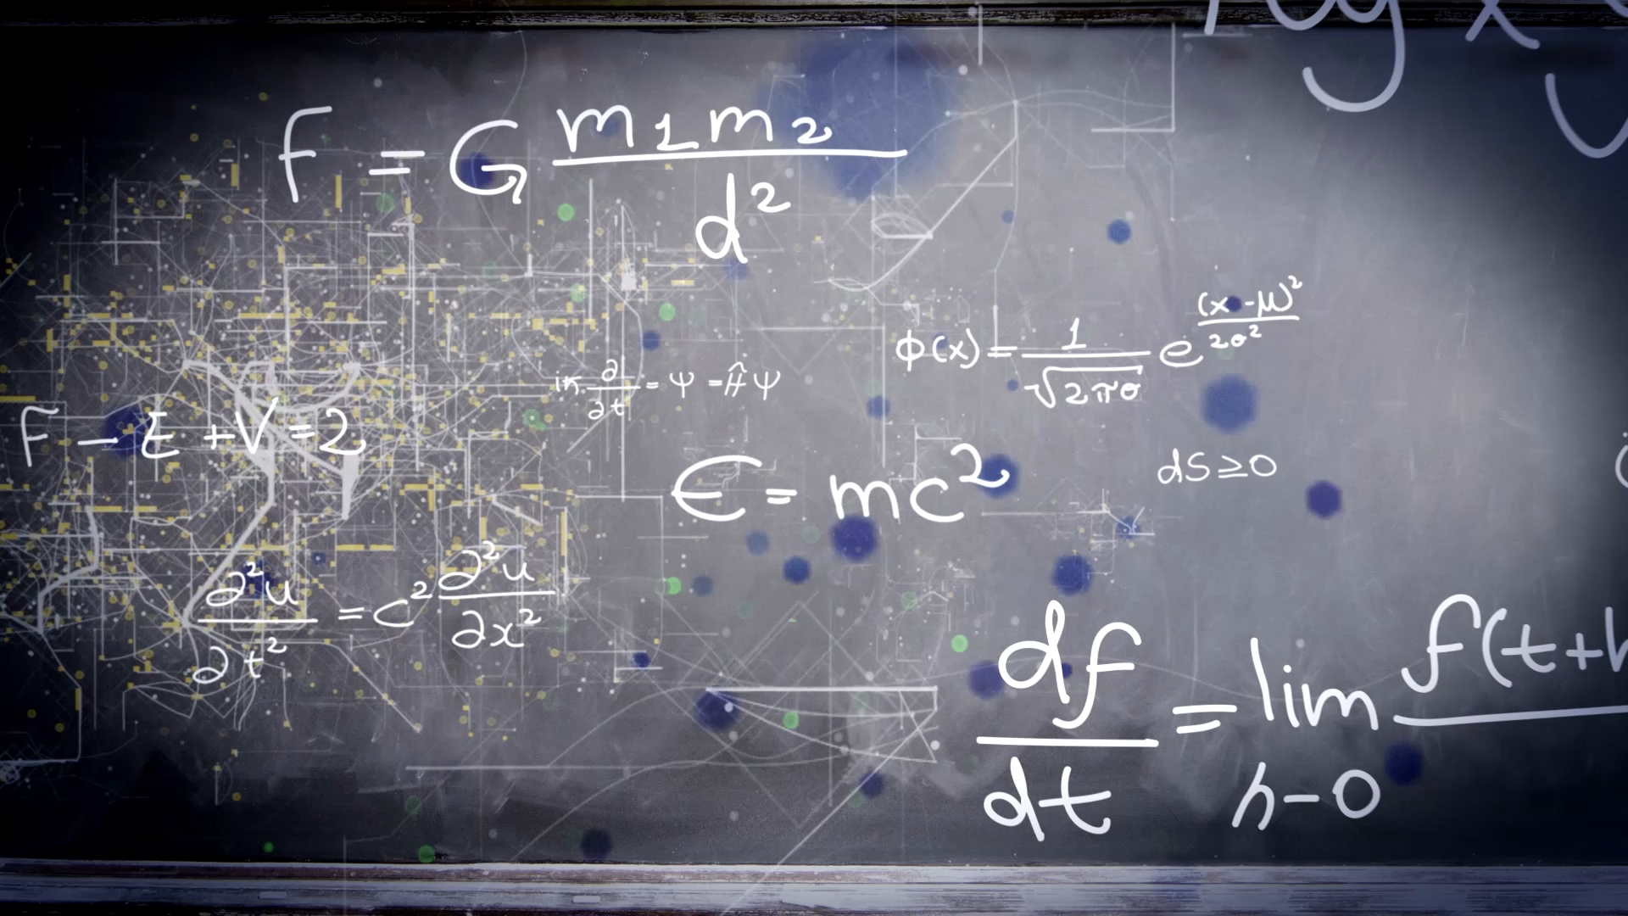
Machine Learning-Based Approach

Slide 6
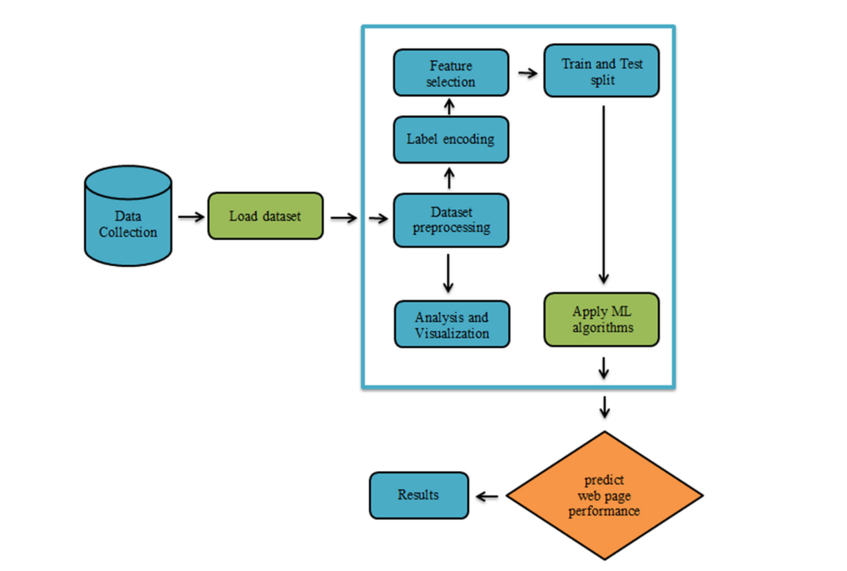
A Novel Approach for Evaluating Web Page Performance Based on Machine Learning Algorithms and Optimization Algorithms
Notes:
This diagram shows the complete machine learning pipeline used to predict web page performance before deployment. It starts with data collection from hundreds of real-world websites, capturing technical and performance-related attributes like load time, DOM size, and page structure.
Once the dataset is loaded, it goes through preprocessing, which includes cleaning the data, encoding categorical features, and preparing it for analysis. The authors also run exploratory analysis and visualization to understand feature distributions and identify outliers.
Next, they apply feature selection to remove irrelevant or redundant features. This step improves model accuracy and reduces overfitting. After splitting the data into training and test sets, they train several classical ML algorithms — including Support Vector Machines, Random Forest, and Logistic Regression — to learn the relationship between web page attributes and their performance classification.
The trained model then outputs a prediction: will a given web page be excellent, acceptable, or poor in terms of performance? This prediction allows developers to identify potential bottlenecks before the site is even launched — turning performance testing into a proactive design tool rather than a reactive process.

Slide 7
Results and discussion
Model | Accuracy (%) | Precision (%) | Recall (%)
SVM | 89 | 88 | 89
Random Forest | 81 | 80 | 81
Logistic Regression | 77 | 76 | 77
k-Nearest Neighbors | 74 | 73 | 74
Naive Bayes | 71 | 70 | 71
Notes:
The results show that Support Vector Machines achieved the highest accuracy at 89%, followed by Random Forest at 81%.
Precision and recall scores support these findings — SVM models are not only accurate, but balanced in detecting both high- and low-performing pages.
This approach demonstrates how ML can act as a core strategy for early performance testing, replacing manual load testing by giving developers insights before deployment even begins.
Importantly, the framework is lightweight and fast, making it suitable for integration into modern CI/CD pipelines.

Slide 8
Deep Learning-Based Approach

Slide 9
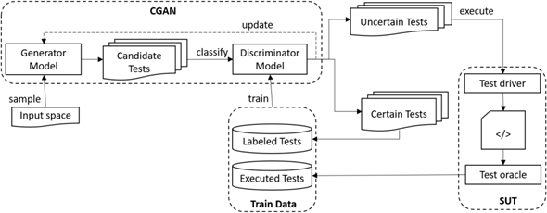
Automated Performance Testing Based on Active Deep Learning
Notes:
This paper introduces ACTA, a deep learning–based framework that automatically generates performance test cases for web applications — especially in black-box environments, where we don’t have access to the system’s internal code or architecture.
The key innovation here is that it uses a Conditional Generative Adversarial Network, or CGAN, to generate test cases that are likely to trigger performance problems — like response delays or resource spikes.
ACTA works like this: the generator creates candidate tests based on input parameters like user IDs, product IDs, or search filters. The discriminator evaluates them and determines which ones are most uncertain — meaning the model isn't confident if they’ll cause a performance issue or not.
Those uncertain tests are actually executed on the real system, and the results are used to improve the model. Over time, this loop allows ACTA to learn how to generate more effective, resource-intensive test cases, with fewer executions and without requiring labeled data up front.
The system is fully automated, adaptable to DevOps, and capable of updating itself as the software evolves — making it a scalable, AI-driven solution for performance testing in modern web applications.

Slide 10
Results
Suite Size | ACTA active | ACTA passive | DN | PerfXRL | Random
5,000 | 4,000 | 4,200 | 4,300 | 2,000 | 1,000
10,000 | 7,800 | 7,900 | 8,100 | 3,900 | 2,000
20,000 | 14,700 | 14,900 | 15,300 | 7,500 | 3,800
30,000 | 21,300 | 21,700 | 22,400 | 10,800 | 5,900
40,000 | 28,600 | 29,100 | 29,800 | 14,500 | 7,500
Notes:
This table shows how ACTA compares to other test generation methods in terms of how many performance-violating test cases it was able to generate at different test suite sizes.
You can see that ACTA active performs nearly as well as DN, the discriminative neural model — and does so with fewer executions, thanks to its active learning loop. ACTA’s passive version also performs strongly.
The key point is how much more effective ACTA is compared to PerfXRL, which is a reinforcement learning–based baseline, and especially to Random testing, which generates the fewest useful test cases across all suite sizes.
For example, with a suite of 40,000 test cases, ACTA active generates over 28,000 positive cases, while random testing finds only 7,500. That’s a nearly 4× improvement, showing how well ACTA learns to target performance bottlenecks with minimal waste.
These results demonstrate that ACTA not only automates performance testing using deep learning but also significantly improves efficiency by learning where to focus its test generation — rather than relying on brute-force or blind exploration.

Slide 11
Reinforcement Learning-Based Approach

Slide 12
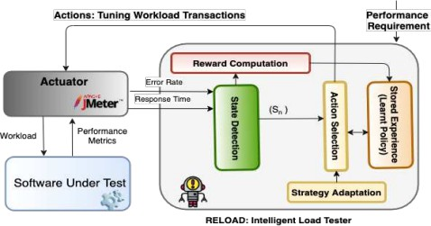
Performance Testing Using a Smart Reinforcement Learning-Driven Test Agent (RELOAD)
Notes:
This diagram shows how the RELOAD agent works to automate performance testing using reinforcement learning.
The testing process begins with Apache JMeter, which acts as an actuator — sending test workloads to the application and capturing performance metrics like response time and error rate.
These metrics are then sent to the RL agent, where they’re processed through a state detection module. Based on the current system state, the agent computes a reward — which measures how close the test came to triggering a performance requirement, like exceeding a certain response time.
The agent then chooses an action — that is, how to adjust the number of users assigned to specific web transactions. These actions are guided by a policy, which improves over time and is stored as “learned experience.”
The strategy adaptation module fine-tunes how the agent explores and exploits new test configurations. This loop continues until the agent learns the most efficient way to stress the system and expose performance bottlenecks.
What’s powerful here is that RELOAD doesn’t need any system internals — it learns everything from black-box interactions, making it highly practical for real-world web applications that are closed-source or constantly evolving.

Slide 13
Results
Configuration | Test Cost Saving vs. Standard Baseline | Test Cost Saving vs. Random Testing
ε = 0.2 | 30% | 17%
ε = 0.5 | 30% | 17%
Decaying ε | 34% | 20%
DQN Setup | 34% | 20%
Notes:
This table shows how RELOAD performs under different reinforcement learning configurations, and how much test cost it saves compared to two baselines: standard performance testing and random workload generation.
We see that with fixed exploration rates (epsilon = 0.2 or 0.5), RELOAD achieves about 30% cost savings compared to standard methods, and 17% savings compared to random testing.
When the agent uses a decaying epsilon, where exploration gradually decreases over time, it performs even better — saving 34% of test cost compared to the standard baseline.
The best performance is also matched by the DQN setup, which uses a neural network to approximate the Q-values instead of a table. That variant also achieves 34% savings over the baseline and 20% compared to random testing.
These results show that RELOAD isn’t just automated — it’s also smarter and more efficient, learning how to reach performance violation thresholds with fewer test executions, and at a significantly lower cost.

Slide 14
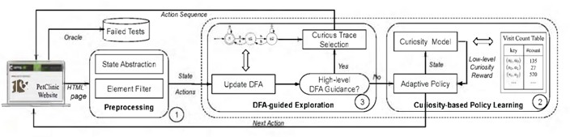
Automatic Web Testing Using Curiosity-Driven Reinforcement Learning (WebExplor)
Notes:
This paper introduces WebExplor, a fully automated web testing framework powered by curiosity-driven reinforcement learning. Unlike traditional testing that requires prior models or manual scripting, WebExplor learns test behaviors directly by interacting with the web application, adapting in real-time.
The core idea is simple but powerful: treat web testing like exploring a maze. Each HTML page is a state, every click or input is an action, and the goal is to discover new behaviors and errors. The agent receives a curiosity reward every time it explores something new — like an unvisited state or sequence.
WebExplor uses two layers of intelligence:
Low-level curiosity-driven RL: encourages exploration by rewarding rare or novel transitions between states.
High-level DFA (Deterministic Finite Automaton): maintains a global view of what’s already been visited. When the agent gets stuck, the DFA suggests a promising path to explore next.
This two-level system helps WebExplor escape local optima — it doesn’t keep testing the same “easy” flows — and instead guides it toward deeper, more complex bugs.
Importantly, this is not pre-trained. Learning and testing happen on the fly, which is crucial for dynamic, modern web apps. The agent adapts to what it sees, builds test sequences in real time, and optimizes coverage and fault discovery as it goes.

Slide 15
Results
Subjects | WebExplor Coverage (%) | Best Baseline Coverage (%) | WebExplor Failures | Best Baseline Failures
Dimeshift | 51.0 | 40.1 (SuBWEB) | 2.9 | 2.9 (SuBWEB)
Pagekit | 36.0 | 31.7 (SuBWEB) | 2.9 | 2.9 (SuBWEB)
Splittypie | 43.4 | 46.9 (DIG) | 6.0 | 4.0 (DIG)
Phoenix | 81.7 | 65.1 (SuBWEB) | 2.1 | 2.0 (DIG)
Retroboard | 61.4 | 71.9 (SuBWEB) | 1.0 | 1.0 (All methods)
PetClinic | 85.0 | 83.0 (WebExplor) | 3.3 | 3.0 (SuBWEB)
Notes:
WebExplor was tested on six real-world open-source web apps, one commercial SaaS platform, and the top 50 global web applications. The results are impressive.
Compared to five state-of-the-art baselines — including both model-based (like DIG and SuBWEB) and model-free tools (like Crawljax and random testing) — WebExplor consistently outperformed them in two key areas:
🔹 Branch coverage: it achieved the highest coverage in 4 out of 6 applications. 🔹 Failure detection: it found the most unique failures overall, even in cases where coverage wasn’t the highest.
In total, WebExplor:
Found 3,466 failures in the top 50 websites.
Found 12 unknown failures in the commercial SaaS platform, all confirmed and fixed by developers.
Detected both logical bugs and security issues, including hidden exceptions, race conditions, and exposed server folders.
What makes WebExplor especially effective is its ability to build test sequences, like navigating through a series of pages and submitting a form — something most random or scripted tools struggle with. And it does all this without requiring a navigation model or human-written inputs.
So in summary, WebExplor uses reinforcement learning not just as a side enhancement, but as the entire backbone of test generation — making it one of the most autonomous and scalable solutions in modern web testing today.

Slide 16
Comparative Analysis

Slide 17
Machine Learning (ML)
Best for early-stage performance prediction
Uses structured metrics (e.g., load time, page size, DOM complexity)
Fast, interpretable, and lightweight
Less effective for dynamic or interactive systems

Slide 18
Deep Learning (DL)
Best for generating complex test inputs to trigger performance bottlenecks
Can model non-linear behavior and system complexity
Effective in black-box stress testing
Requires large datasets, high compute power, and longer training time

Slide 19
Reinforcement Learning (RL)
Best for dynamic, autonomous exploration of modern web apps
Learns through trial-and-error in real time
Requires no system internals — suitable for black-box testing
Slower to train and sensitive to reward design

Slide 20
RESEARCH GAPS AND CHALLENGES

Slide 21
Lack of high-quality, diverse performance datasets for training AI models
Poor generalization of models across different web architectures
DL and RL methods often lack interpretability ("black-box" behavior)
High computational cost and complexity, especially for RL and DL
No standardized benchmarks for evaluating AI-based performance testing tools
Reward design in RL remains trial-and-error and difficult to tune effectively

Slide 22

CONCLUSION AND FUTURE WORK

Slide 23
AI is transforming web performance testing from manual and reactive to automated and proactive
ML enables early prediction, DL enables stress testing, RL enables autonomous exploration
Each approach suits different stages and goals in the testing lifecycle
Future work should focus on:
Developing lightweight, explainable, and transferable AI testing methods
Creating standard benchmarks and shared datasets
Exploring hybrid models that combine strengths of ML, DL, and RL

Slide 24

Questions?

